Slide 1
How does a bike-share navigate speedy success?
Adrianna Boursalian
March 2024

Slide 2
Goal:
Recommendation:
Design marketing strategies aimed at converting casual riders into annual members.
Implement billboard advertisements for annual memberships within the vicinity of the most popular start stations that casual riders begin their bike trips from.
Since casual riders take longer bike trips on average, create a promotional campaign for discounted annual memberships for riders who travel “x” amount of time per trip.
Further analysis on who the casual customer base is should be explored so we can strategically target that demographic. Additional user data to be explored could include casual rider addresses, occupations, income levels, and their transportation options.

Slide 3
Analytical goals
WHY: Cyclistic’s future success depends on maximizing the number of annual memberships, as finance analysts concluded that annual members are much more profitable than casual riders.
HOW: Understand how annual members and casual riders differ, why casual riders would buy a membership, and how digital media could affect their marketing tactics.

Slide 4
Analytical goals
WHY: Cyclistic’s future success depends on maximizing the number of annual memberships, as finance analysts concluded that annual members are much more profitable than casual riders.
HOW: Understand how annual members and casual riders differ, why casual riders would buy a membership, and how digital media could affect their marketing tactics.

Slide 5
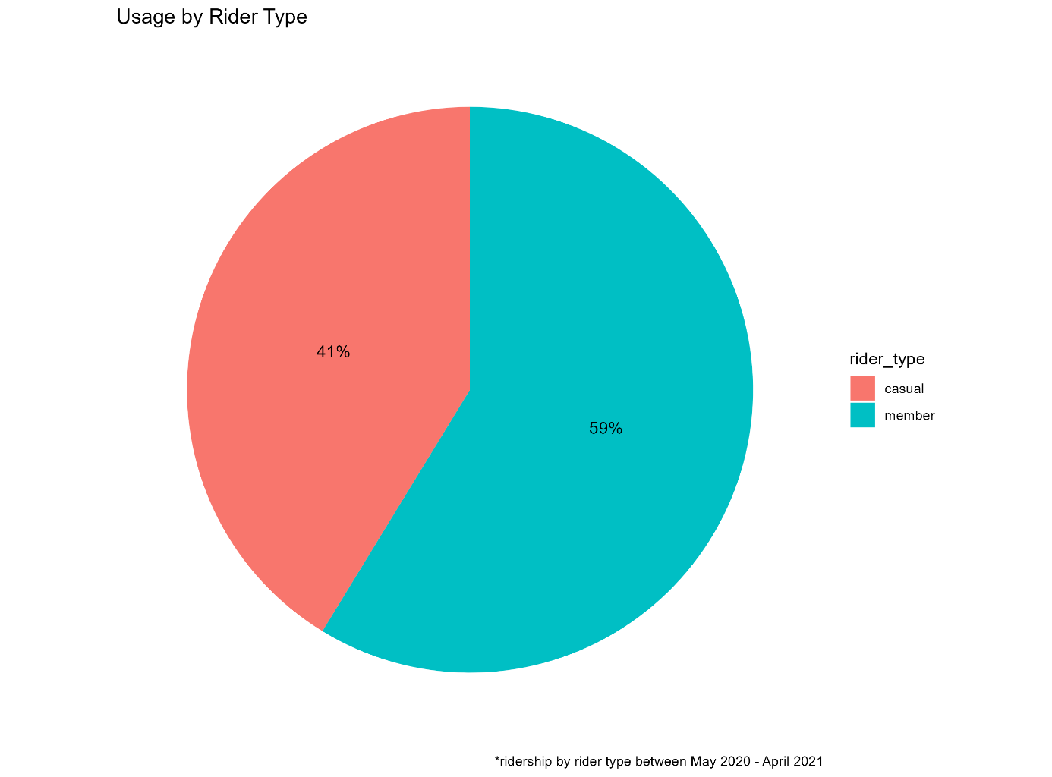
Ridership composition
59% of Cyclistic riders between May 2020 and April 2021 were annual members, and 41% were casual riders.
Source: Chicago Department of Transportation: Divvy system data by month (May 2020 - April 2021)

Slide 6
A considerable share of Cyclistic’s bike-share program consists of casual riders. If annual memberships are more profitable for the company, converting as many casual riders as possible to members will boost Cyclistic’s profitability as there is sizable market potential.

Slide 7
Analytical goals
WHY: Cyclistic’s future success depends on maximizing the number of annual memberships, as finance analysts concluded that annual members are much more profitable than casual riders.
HOW: Understand how annual members and casual riders differ, why casual riders would buy a membership, and how digital media could affect their marketing tactics.

Slide 8
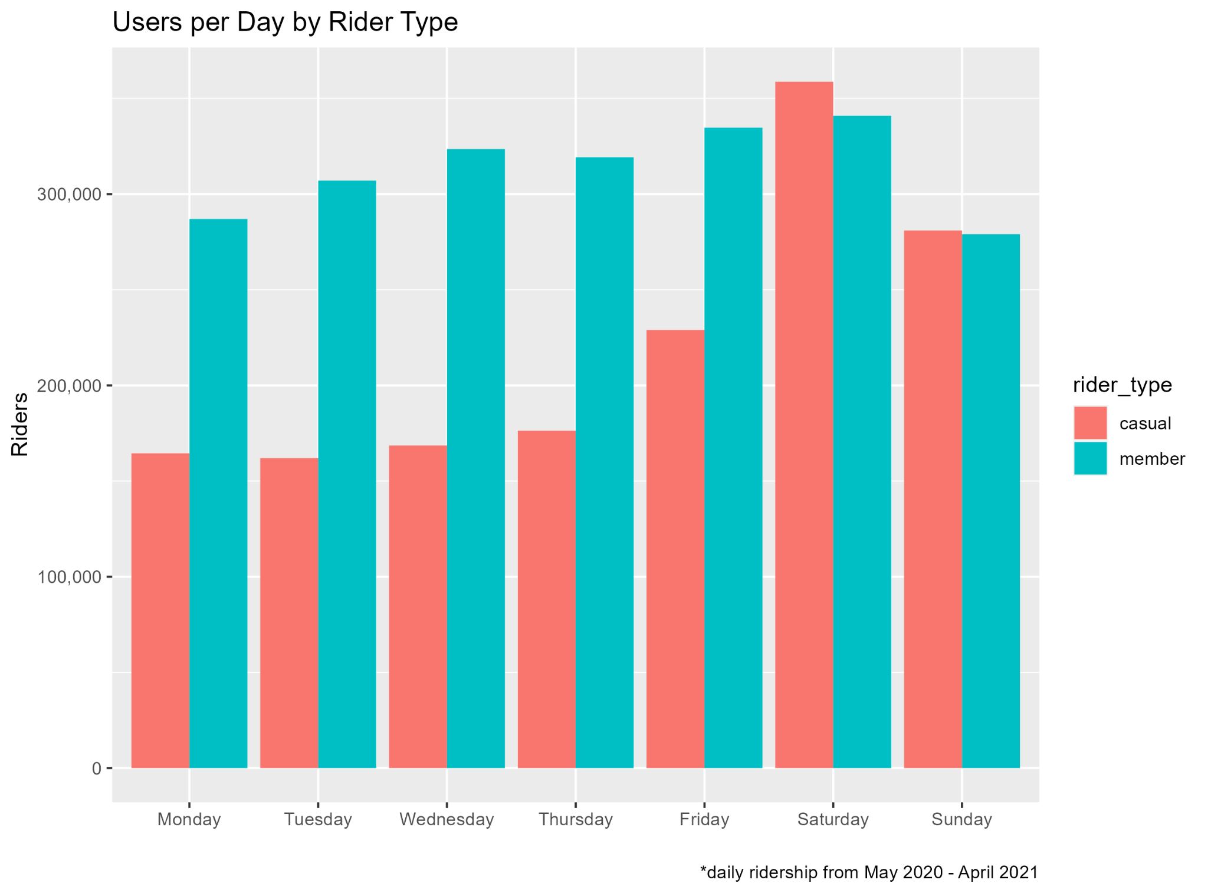
Member ridership > casual ridership
Member ridership count per day outpaced casual riders on weekdays.
However, the number of casual riders outpaced members on weekends.
Source: Chicago Department of Transportation: Divvy system data by month (May 2020 - April 2021)

Slide 9
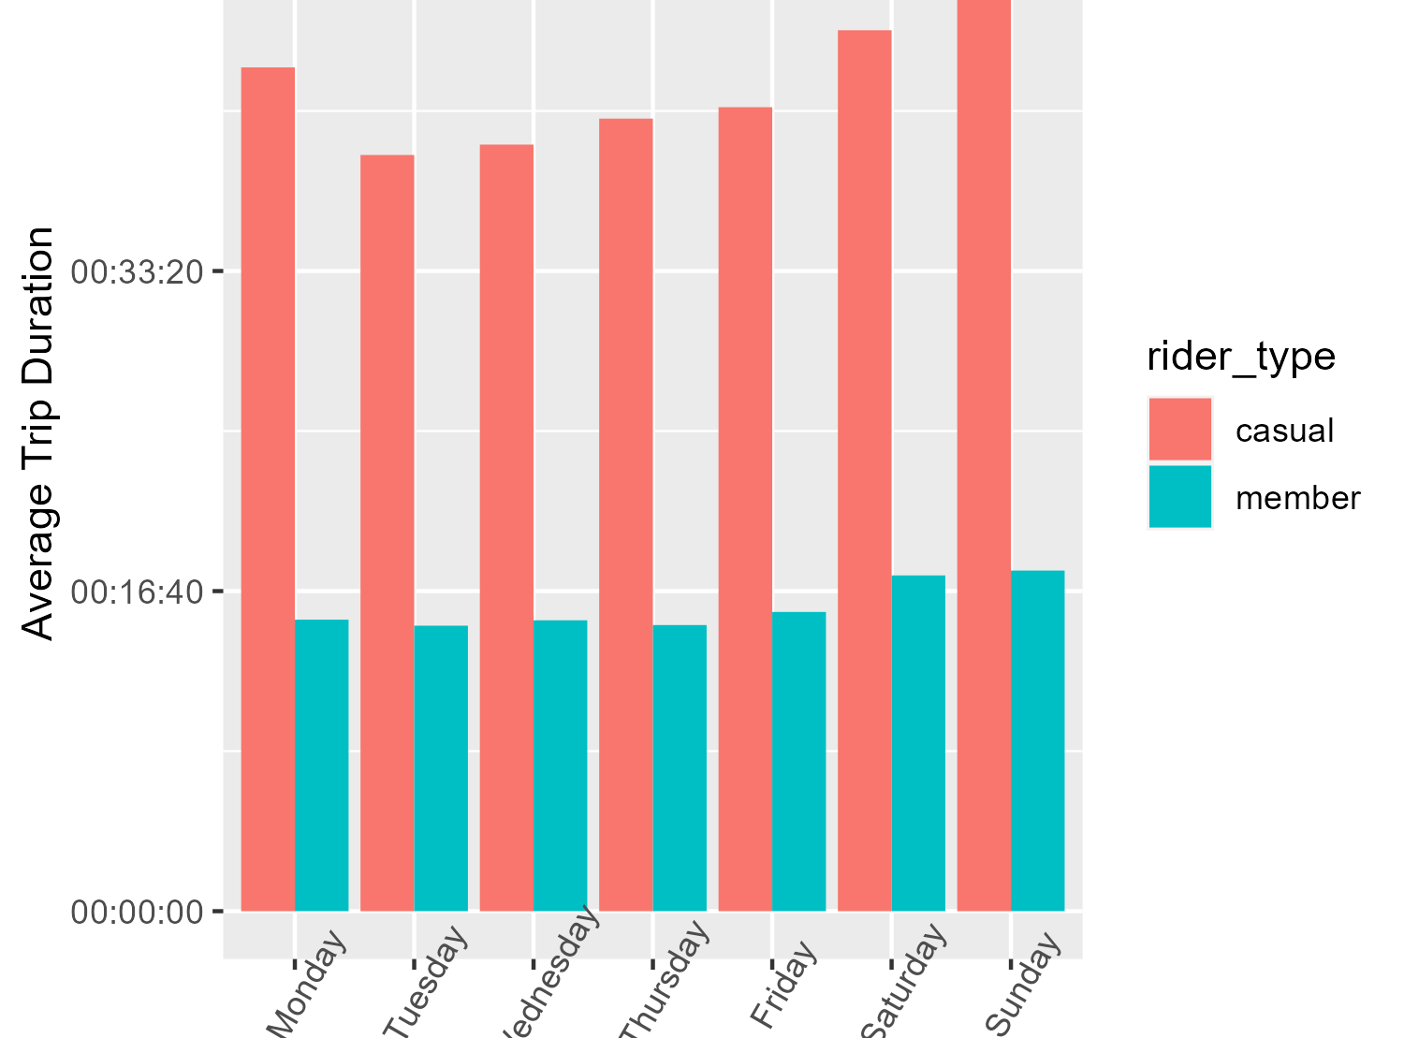
Average Trip Duration per day by Rider Type
Casual riders took longer trips
Although member ridership was higher than casual ridership, casual rider trips were about three times longer than member rider trips on average.
Source: Chicago Department of Transportation: Divvy system data by month (May 2020 - April 2021)

Slide 10
Casual riders’ average trip duration was about three times longer than members for every day of the week
A promotional rate to convert casual riders to annual members if they take trips for “x” amount of minutes may appeal to casual riders enough to purchase the membership so they get more for their money with each ride.

Slide 11
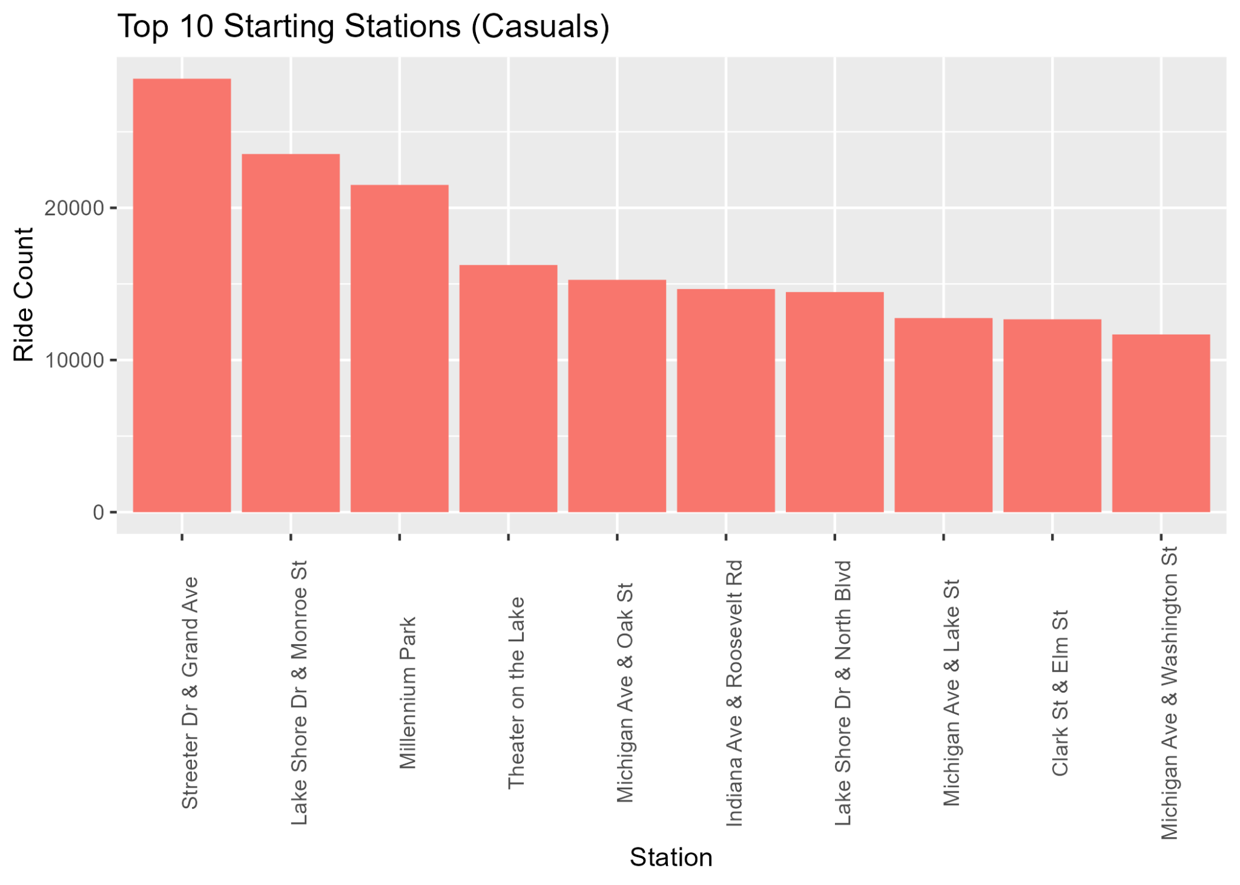
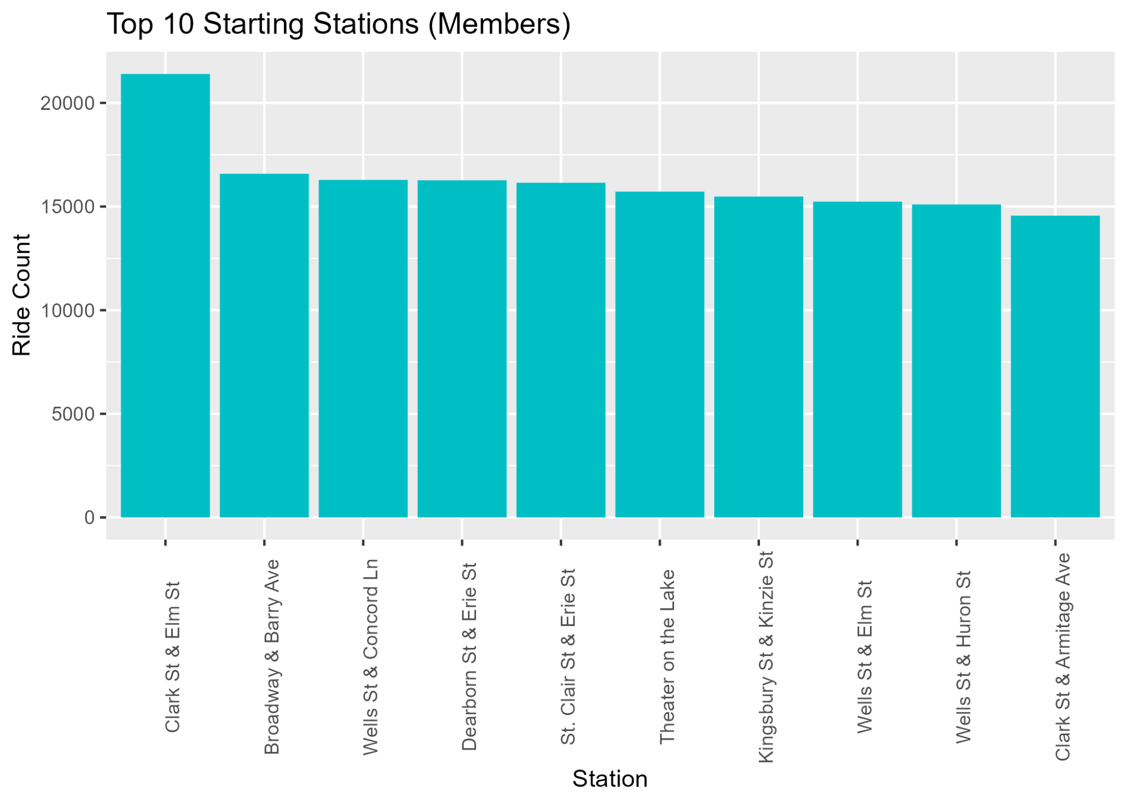
Source: Chicago Department of Transportation: Divvy system data by month (May 2020 - April 2021)
Casual riders and members tended to begin their trips from different starting stations.

Slide 12
We can infer that riders likely live close by their start stations. We could implement advertisements for annual memberships around the vicinity of the top start stations for casual riders to reach user by the masses.

Slide 13
In Summary
WHY: Casual riders leverage Cyclistic’s bike-share program frequently enough that creating effective campaigns can convert them to annual members and will in turn increase company profitability.
HOW: Create a promotional for memberships target at casual riders traveling for “x” duration per trip, and erect ads within a radius of casual riders’ top ride start points.

Slide 14
Further Exploration for v2
Gather metrics on the marketing campaigns implemented and compare annual memberships over a specified period of time.
Did the implementation of the marketing campaigns correlate to growth in memberships?
Gather more granular data on who the casual rider customer base is so we can further tailor an effective marketing strategy to casul riders

Slide 15
Thank You.

